Slide 1



Working in the Community
and Developing Partnerships

Slide 2
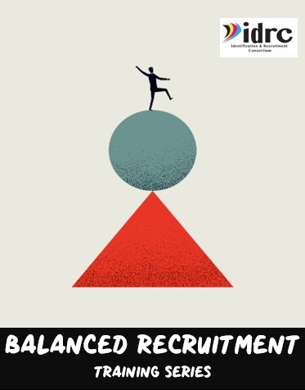
Four Training Resources
IDRC has developed a four-part training series that covers each of the four areas of Balanced Recruitment.
Use the resources to review your current efforts and see if there are any additional areas that you can expand your ID&R efforts.

Slide 3
What is Balanced Recruitment?
For MEP programs to be successful it is necessary to ensure that all areas of the state are thoroughly canvassed through Balanced Recruitment Efforts.
This involves canvassing housing, working to recruit in the community and develop partnerships with community agencies, developing partnerships with farms, fisheries, and agribusinesses as well as working with schools.

Slide 4
What is Balanced Recruitment?
Community Recruitment
Housing
Farms, Fishing, Agribusiness
Schools
All four areas are essential to developing successful Identification and Recruitment Efforts.

Slide 5

What this training covers…
Why Community Recruitment is a key area to conduct ID&R.
How to locate places where you can find migrant families.
How to get community groups to refer to you by building relationships.
How to organize the information, plan visits/outreach
Ideas for interactions and interviews.

Slide 6
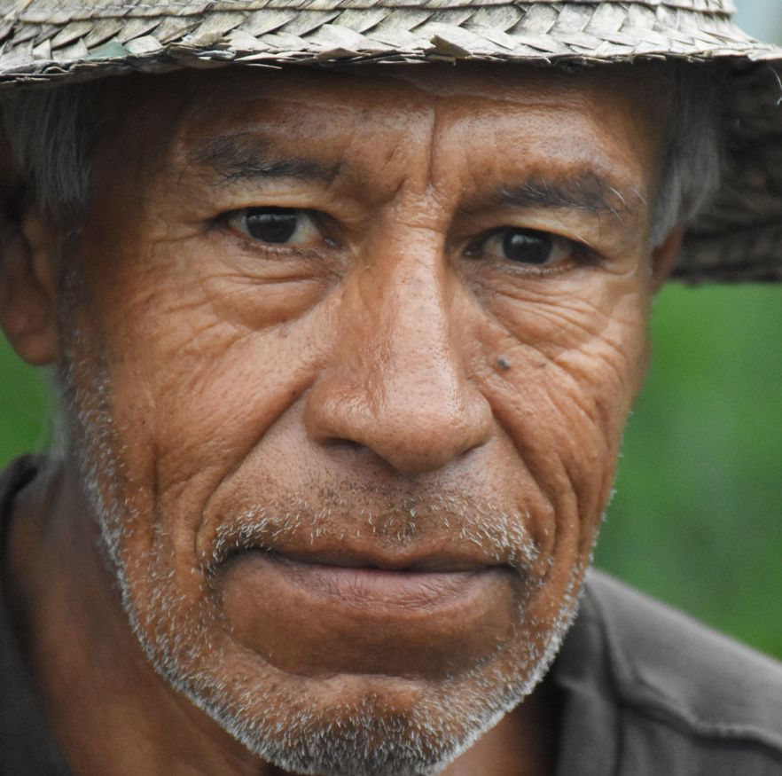
Working in the Community
Working in the community is a key component of a successful MEP program.
Migrant families live and work in communities and visit all sorts of agencies and locations.

Slide 7

Working in the Community
It is not always possible to find them at home, at school, or at work. Therefore, community recruitment is also essential.
As recruiters are working, they should always be identifying more locations in their communities that are good to recruit at.

Slide 8
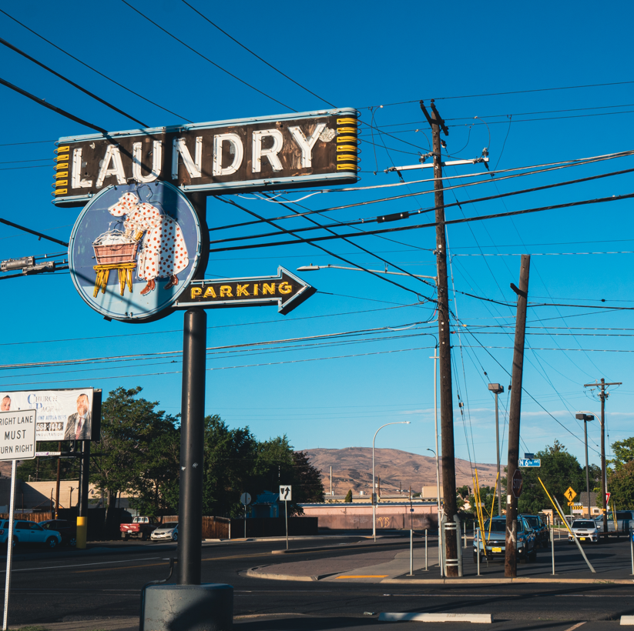
Community Recruitment consists of…
Working to identify and visit places that migrant families frequent.
These can be business establishments such as stores, markets, laundromats, etc.

Slide 9

Community Recruitment consists of…
They can also be locations like churches and agencies like health clinics, tax offices, employment agencies and many more.
A recruiter needs to be able to identify places where migrant families frequent often as well as places that offer resources to migrant families or that could provide referrals of possible eligible families.

Slide 10

It can be helpful to…
Make note of places you pass as you are out in the community that would be good to visit.
Spend some time researching different agencies in the community that offer resources to migrant families or that are currently working with the farm worker community.

Slide 11

It can be helpful to…
Go and visit these locations always with the idea to learn more about what they do, see how you can possibly work together in the future, and learn of resources you can share with families.
Keep good notes of who you talk to and any follow up that is needed.

Slide 12

Learn which agencies may have helpful data…
This could include where migrant families are working or living for example.
Employment Agencies, Agriculture Extension Offices, State Monitor Advocates, etc.

Slide 13

Learn which agencies may have helpful data…
USDA Agriculture Extension Agents are an example of this. Farmers usually trust them, and they have access to a lot of agricultural data.
The Agriculture Agent may not see a direct benefit to working with the MEP so that trust will need to be built. It would be helpful for MEP to show this agent what they have that could benefit the farmers that the extension offices work with.
Find your Ag Extension Agent here: https://www.nifa.usda.gov/land-grant-colleges-and-universities-partner-website-directory

Slide 14
Working Together
Adult Education
Community Health Programs
Boys and Girls Clubs
Head Start Programs
Employment offices
Various community agencies often work with Migrant families and be great sources of referrals as well as resources that you can make sure families or youth are aware of.

Slide 15

Visit often and continue to build contacts
Some community locations just need to be visited frequently. An example of this is a laundromat. It can be helpful to visit on a rainy day, in the evening or on the weekend.
Other locations require more work to get permission to work together to conduct joint efforts. This may be appropriate for something like the Migrant Head Start Program. Since they serve a similar population, it would make sense to work together.

Slide 16

Both Sides Should Benefit
Partnerships don’t happen overnight. Both sides should bring something to the table. Always be looking to find agencies that can offer referrals of new families or resources that can be shared with families.

Slide 17

Getting the Word Out to Your Partners
Make sure you have fliers and pamphlets and social media resources that you can share with your potential partners.
Ensure these clearly show what the MEP can offer to create realistic expectations that your program can follow through on.

Slide 18

Things to Think About
Brainstorm how you can both mutually benefit both sides of the partnership.
Always follow up with everything you say you are going to do.
Make sure your MEP services are beneficial to your students or they will see through you. You have to offer something high quality to those you serve.

Slide 19
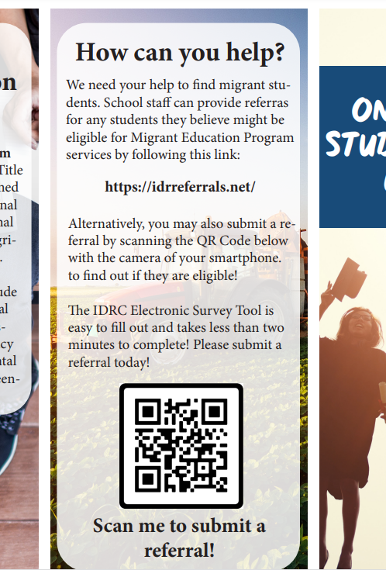
Market to the Community
Make sure you have the right materials posted in the right places to get as many referrals as possible.
Maybe your materials should vary in their message. Maybe a flier that says, “Want to learn English?” might be a good flier to put in an area where OSY frequent. A “Is your child struggling in School?” flier might be helpful to attract a parent or guardian’s attention.

Slide 20

Market to the Community
Think out your marketing strategy and help get the word out about the program. Use local resources such as radio, billboards, and print as needed also.

Slide 21
Know your Resources
If you do thorough community recruitment you will know where your families frequent and visit those places often.
You will know what resources are available in your community and how to help MEP families gain access to those resources when they are needed.

Slide 22

Know your Resources
You will develop key contacts and build relationships with programs that serve the same population.
You will be able to maximize MEP resources for the benefit of MEP students and families.

Slide 23

Possible Community Locations or Agencies that recruiters should visit
Laundromats
Grocery or Ethnic Stores
Health Clinics/ Departments
Head Start Programs
Employment Offices
Agriculture Extension Offices
Adult Education Programs
WIC offices
Boys and Girls Clubs
Crop Insurance Agencies
Chamber of Commerce
Police Departments
Department of Labor
Recruiters should visit any agency that would work with migrant families and could provide a referral of possible eligible families or offer a resource that would be beneficial for MEP families and youth.

Slide 24
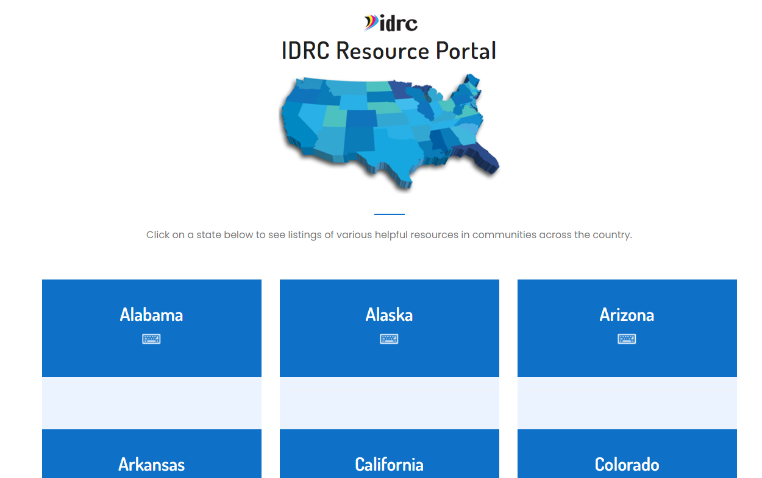
IDRC Resource Portal
Make sure to access the IDRC Resource Portal. There are listings of all sorts of community agencies that you can reach out in your community.
Access it here. https://www.idr-consortium.net/portal/ResourcePortal.html

